Slide 1
Analysis and Prediction of NFTs

Slide 2
Team Members
Ishika Gahane - 29
Maithili Kulkarni - 34
Riya Kamble - 52
Tanushree Manekar - 69

Slide 3
NFTs
NFT stands for Non-Fungible Tokens .
NFTs are digital items that can be bought and sold using blockchain technology.
They are not fungible, making them a different type of asset, one that is based on value and popularity.
2022 is expected to be the year of non-fungible tokens (NFTs).

Slide 4
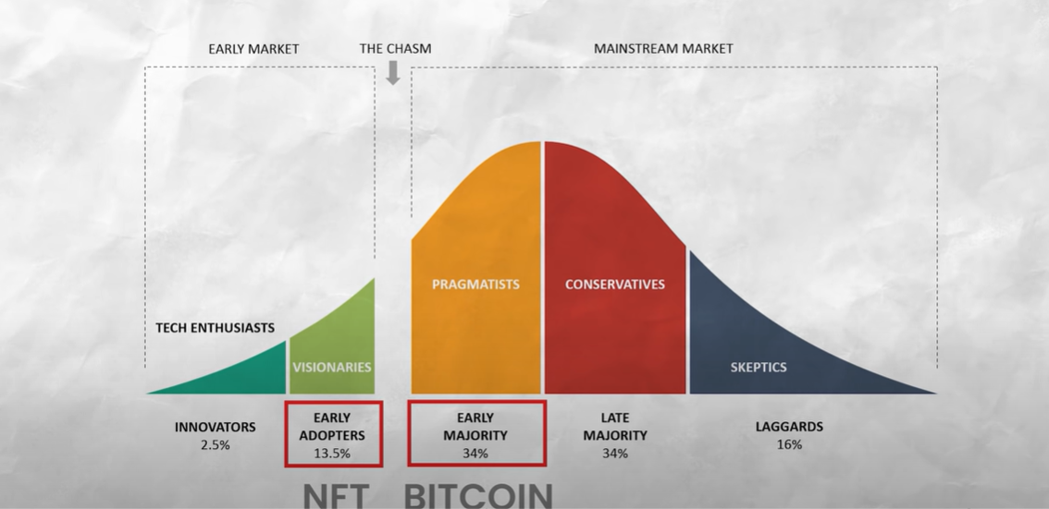
Problem Statement
The below diagram is the Technology Adoption cycle that describes the adoption of new things in society where NFTs is at early stages .
This is because most people truly don’t understand it and don’t have proper knowledge about this.
There is a fairly large supply and demand gap in the Indian NFT market.
And people are still sceptical about investing in NFTs.

Slide 5
Proposed Solution
We are building a platform where we will be doing exploratory data analysis on NFT and predicting the future trends and prices of NFTs using Machine Learning.

Slide 6
THANK YOU

